Slide 1

Software Quality, Verification, and Validation
Dr. Tauseef Jamal

Slide 2
When is software ready for release?

Slide 3
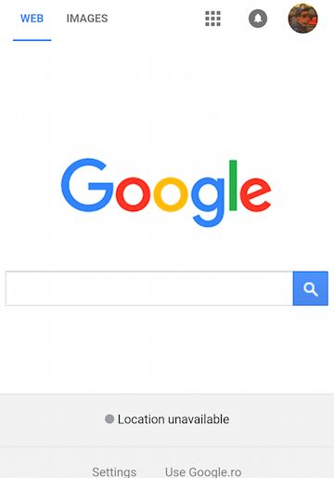
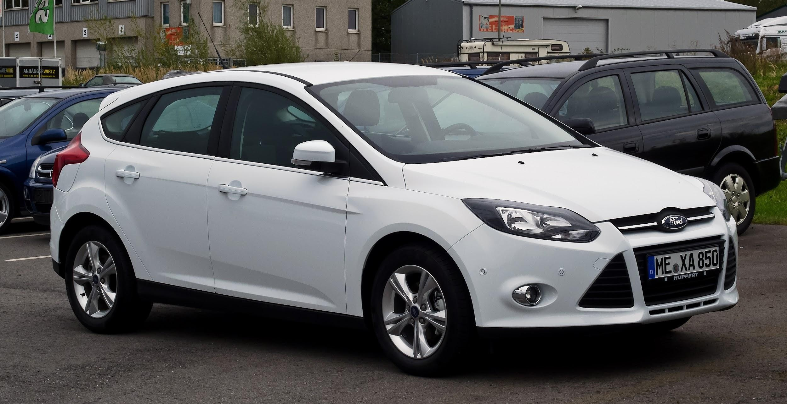

Our Society Depends on Software
This is software: So is this:
Also, this:

Slide 4
Flawed Software Will Hurt Profits
“Bugs cost the U.S. economy $60 billion annually… and testing would relieve one-third of the cost.”
- NIST
“Finding and fixing a software problem after delivery is often 100 times more expensive than finding and fixing it before.”
- Barry Boehm (TRW Emeritus Professor, USC)

Slide 5
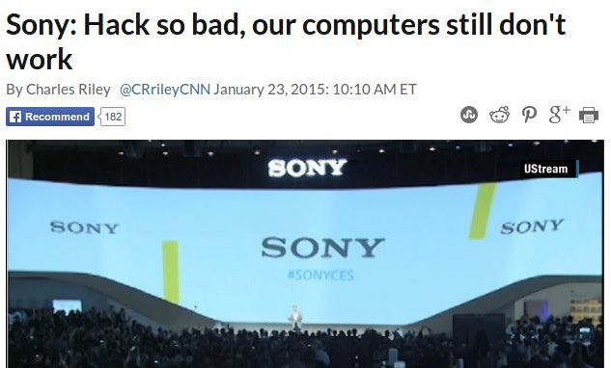
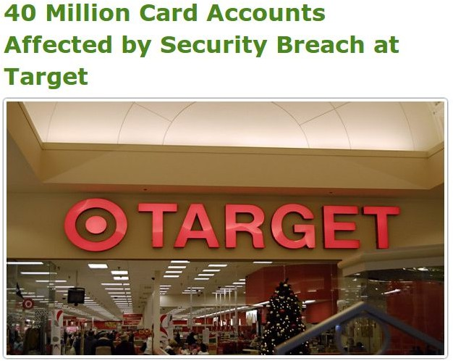
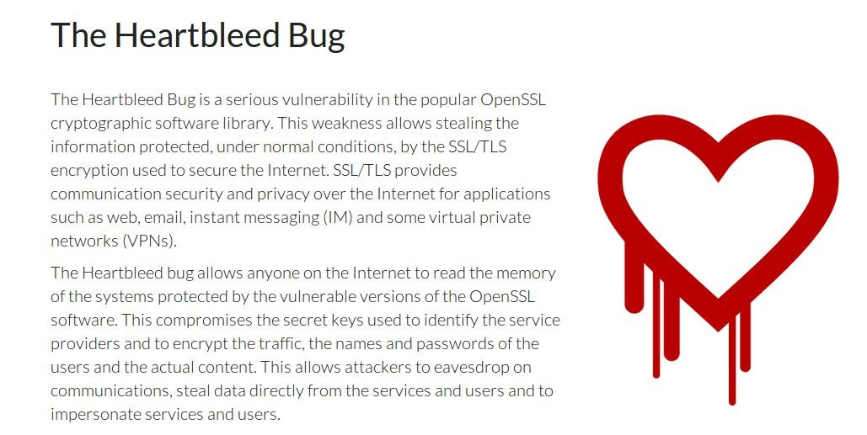
Flawed Software Will Be Exploited

Slide 6
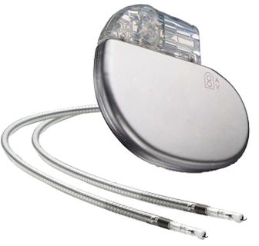
Flawed Software Will Hurt People
In 2010, software faults were responsible for 26% of medical device recalls.
“There is a reasonable probability that use of these products will cause serious adverse health consequences or death.”
- US Food and Drug Administration

Slide 7
When is software ready for release?

Slide 8
The short (and not so simple) answers...
We release when we can’t find any bugs…
We release when we have finished testing…
We release when quality is high...

Slide 9
Software Quality
We all want high-quality software.
We don’t all agree on the definition of quality.
Quality encompasses both what the system does and how it does it.
How quickly it runs.
How secure it is.
How available its services are.
How easily it scales to more users.
Quality is hard to measure and assess objectively.

Slide 10
Quality Attributes
Describe desired properties of the system.
Developers prioritize attributes and design system that meets chosen thresholds.
Most relevant for this course: dependability
Ability to consistently offer correct functionality, even under unforeseen or unsafe conditions.

Slide 11
Quality Attributes
Performance
Ability to meet timing requirements. When events occur, the system must respond quickly.
Security
Ability to protect information from unauthorized access while providing service to authorized users.
Scalability
Ability to “grow” the system to process more concurrent requests.

Slide 12
Quality Attributes
Availability
Ability to carry out a task when needed, to minimize “downtime”, and to recover from failures.
Modifiability
Ability to enhance software by fixing issues, adding features, and adapting to new environments.
Testability
Ability to easily identify faults in a system.
Probability that a fault will result in a visible failure.

Slide 13
Quality Attributes
Interoperability
Ability to exchange information with and provide functionality to other systems.
Usability
Ability to enable users to perform tasks and provide support to users.
How easy it is to use the system, learn features, adapt to
meet user needs, and increase confidence and satisfaction in usage.

Slide 14
Other Quality Attributes
Resilience
Supportability
Portability
Development Efficiency
Time to Deliver
Tool Support
Geographic Distribution

Slide 15
Quality Attributes
These qualities often conflict.
Fewer subsystems improves performance, but hurts modifiability.
Redundant data helps availability, but lessens security.
Localizing safety-critical features ensures safety, but degrades performance.
Important to decide what is important, and set a threshold on when it is “good enough”.

Slide 16
When is Software Ready for Release?
Software is ready for release when you can argue that it is dependable.
Correct, reliable, safe, and robust.
Shown through Verification and Validation.

Slide 17
Verification and Validation
Activities that must be performed to consider the software “done.”
Verification: The process of proving that the software conforms to its specified functional and non-functional requirements.
Validation: The process of proving that the software meets the customer’s true requirements, needs, and expectations.

Slide 18
Verification and Validation
Barry Boehm, inventor of the term “software engineering”, describes them as:
Verification:
“Are we building the product right?”
Validation:
“Are we building the right product?”

Slide 19
Verification
Is the implementation consistent with its specification?
Does the software work under conditions we set?
(usually based on requirements)
Verification is an experiment.
Perform trials, evaluate results, gather evidence.

Slide 20
Verification
Is a implementation consistent with a specification?
“Specification” and “implementation” are roles.
Usually source code and requirement specification.
But also…
Detailed design and high-level architecture.
Design and requirements.
Test cases and requirements.
Source code and user manuals.

Slide 21
Software Testing
Test Input
An investigation into system quality.
Based on sequences of stimuli and
observations.
SUT
Stimuli that the system must react to.
Observations of system reactions.
Verdicts on correctness.
Output
Test Oracle (Expected Output)
Verdict (Pass/Fail)
In computing, software engineering, and software testing, a test oracle (or just oracle) is a mechanism for determining whether a test has passed or failed.
SUT: software under test

Slide 22
Validation
Does the product work in the real world?
Does the software fulfill the users’ actual needs?
Not the same as conforming to a specification.
If we specify two buttons and implement all behaviors related to those buttons, we can achieve verification.
If the user expected a third button, we have not achieved validation.

Slide 23
Verification and Validation
Verification
Does the software work as intended?
Shows that software is dependable.
Validation
Does the software meet the needs of your users?
Shows that software is useful.
This is much harder.

Slide 24
Verification and Validation
Both are important.
A well-verified system might not meet the user’s needs.
A system can’t meet the user’s needs unless it is well-constructed.
This class largely focuses on verification.
Testing is the primary activity of verification.

Slide 25
Required Level of V&V
Depends on:
Software Purpose: The more critical, the more important that it is reliable.
User Expectations: Users may tolerate bugs because benefits outweigh cost of failure recovery.
Marketing Environment: Competing products - features and cost - and speed to market.

Slide 26
Basic Questions
When do verification and validation start and end?
How do we obtain acceptable quality at an acceptable cost?
How can we assess readiness for release?
How can we control quality of successive releases?
How can the development process be improved to make verification more effective?

Slide 27
When Does V&V Start?
V&V can start as soon as the project starts.
Feasibility studies must consider quality assessment.
Requirements can be used to derive test cases.
Design can be verified against requirements.
Code can be verified against design and requirements.
Feedback can be sought from stakeholders at any time.

Slide 28

Static Verification
Analysis of system artifacts to discover problems.
Proofs: Posing hypotheses and making arguments using specifications, models, etc.
Inspections: Manual “sanity check” on artifacts (e.g., source code), searching for issues.

Slide 29
Advantages of Static Verification
One error can hide other errors. Inspections not impacted by program interactions.
Incomplete systems can be inspected without special code to run partial system.
Inspection can assess quality attributes such as maintainability, portability, code style, program inefficiencies, etc.

Slide 30
Dynamic Verification
Exercising and observing the system to argue that it meets the requirements.
Testing: Formulating sets of input to demonstrate requirement satisfaction or find faults.
Fuzzing: Generating semi-random input to locate crashes and other anomalies.
Taint Analysis: Monitoring how faults spread by corrupting system variables.

Slide 31
Advantages of Dynamic Verification
Discovers problems from runtime interaction, timing problems, or performance issues.
Often cheaper than static verification.
Easier to automate.
However, cannot prove that properties are met
Cannot try all possible executions.

Slide 32
The Trade-Off Game
Software engineering is the process of designing, constructing and maintaining the best software possible given the available resources.
Trade off between what we want, what we need, and what we've got.
“Better, faster, or cheaper - pick any two”

Slide 33
Perfect Verification
Verification is an instance of the halting problem.
There is at least one program for which any technique cannot obtain an answer in finite time.
Testing - cannot exhaustively try all inputs.
Must accept some degree of inaccuracy.

Slide 34
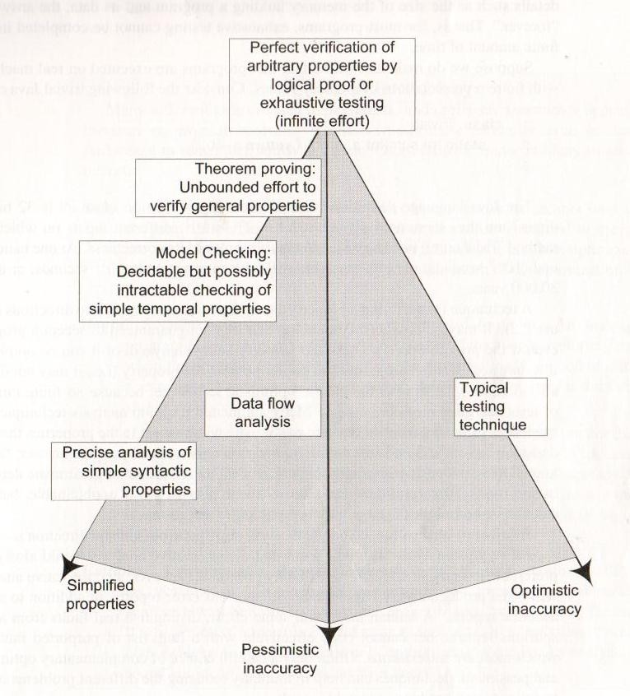
Verification Trade-Offs
We are interested in proving that a program demonstrates property X
Pessimistic Inaccuracy - not guaranteed to program even if the it possesses X.
Optimistic Inaccuracy - may accept program that does not possess X.
Property Complexity - if X is too difficult to check, substitute simpler property Y.

Slide 35
How Can We Assess Readiness?
Finding all faults is nearly impossible.
Instead, decide when to stop V&V.
Need to establish criteria for acceptance.
How good is “good enough”?
Measure dependability and other quality attributes and set threshold to meet.

Slide 36
Product Readiness
Put it in the hands of human users.
Alpha/Beta Testing
Small group of users using the product, reporting feedback and failures.
Use this to judge product readiness.
Make use of dependability metrics for quantitative judgement (metric > threshold).
Make use of surveys as a qualitative judgement.

Slide 37
Ensuring Quality of Successive Releases
V&V do not end with the release of the software.
Software evolves - new features, environmental adaptations, bug fixes.
Need to test code, retest old code, track changes.
When code changes, rerun tests to ensure tested elements still works.
Retain tests that exposed faults to ensure they do not return.

Slide 38
Improving the Development Process
Try to learn from your mistakes in the next project.
Collect data during development.
Fault information, bug reports, project metrics (complexity, # classes, # lines of code, test coverage, etc.).
Classify faults into categories.
Look for common mistakes.
Learn how to avoid such mistakes.
Share information within your organization.

Slide 39
We Have Learned
Quality attributes describe desired properties of the system under development.
Dependability, scalability, performance, availability, security, maintainability, testability, ...
Developers must prioritize quality attributes and design a system that meets chosen thresholds.
Quality is often subjective. Choose a definition, and offer objective thresholds.

Slide 40
We Have Learned
Software should be dependable and useful before it is released into the world.
Verification is the process of demonstrating that an implementation meets its specification.
This is the primary means of making software dependable (and demonstrating dependability).
Testing is most common form of verification.

